Slide 1
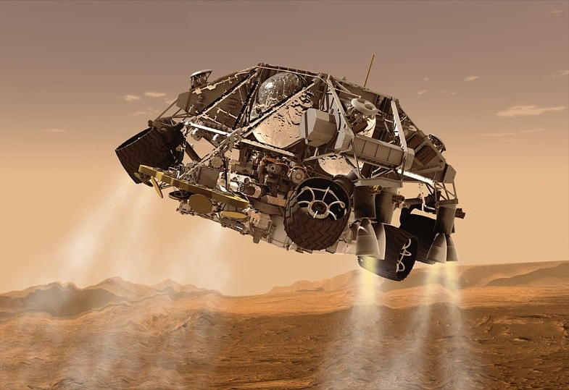
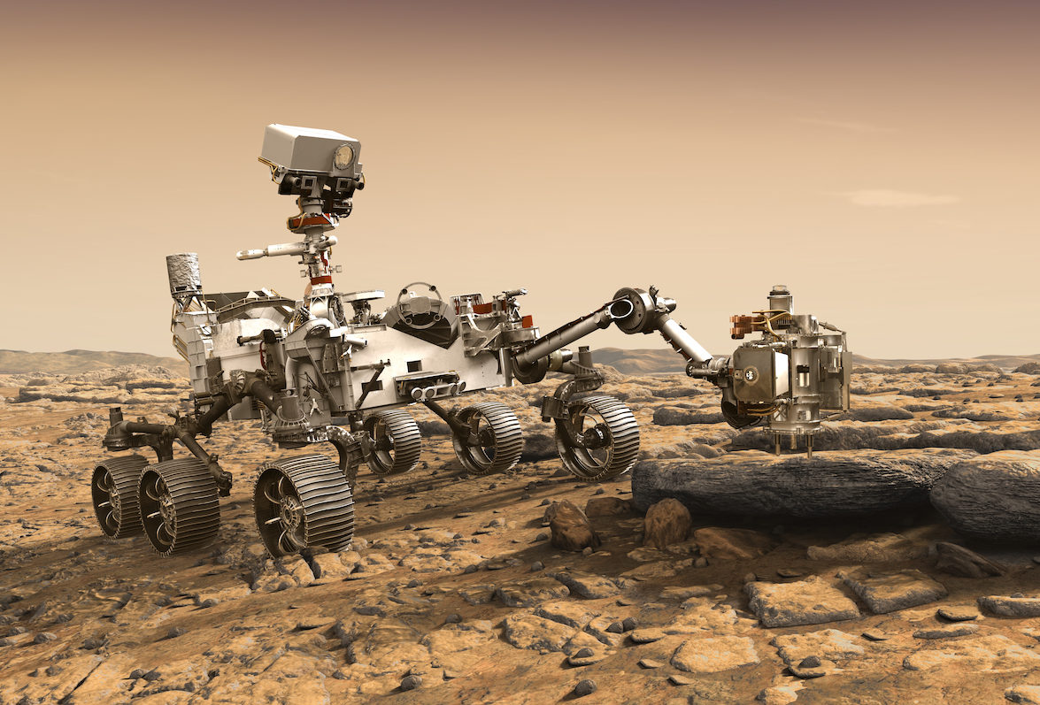
Mission to Mars
Build Your Own Robotic Rover

Slide 2
What This Camp Is About
Building and testing a robotic rover
Robotics
Coding
Teamwork
Problem-solving
Competition

Slide 3
Camp Schedule Overview
Week #1
Day 1: Intro & Mars Environment
Day 2: Engineering for the Red Planet
Day 3: Drivetrain for Martian Terrain
Day 4: Build a Mecanum Drivetrain
Day 5: Powering your Mars Rover
Week #2
Day 6: Building Mars Rover Actuators
Day 7: Designing a Claw
Day 8: Get Rover to Collect a Sample
Day 9: Controlling the Mars Rover Arm
Day 10: Mars Rover Showcase

Slide 4
Classroom Expectations
Be a Team Player
Collaborate and share ideas
Include everyone in group work
Take turns and support each other
Be Safe
Follow safety guidelines around tools
Keep walkways clear and organized
Ask before using unfamiliar equipment
Be Curious and Have Fun!
Ask questions and explore
Learn from mistakes – that’s how engineers grow!
Celebrate progress, big or small
Be Respectful
Listen actively when others are speaking
Treat teammates and equipment with care
Use kind and appropriate language
Be Responsible
Come prepared and on time
Stay on task and follow instructions
Take care of tools, laptops, and robot parts

Slide 5

Safety Protocols
Always wear safety goggles when working with tools.
Pay close attention when using sharp parts and tools.
Keep your workspace organized; loose screws can be dangerous.
Never rush — take your time to build carefully.
Report any injuries or broken equipment immediately.
No horseplay around robotics equipment.
Wash hands after working with materials.

Slide 6

Two Truths and a Lie
Each person says three statements about themselves.
Two should be true, and one should be a lie.
Others guess which one is the lie!

Slide 7
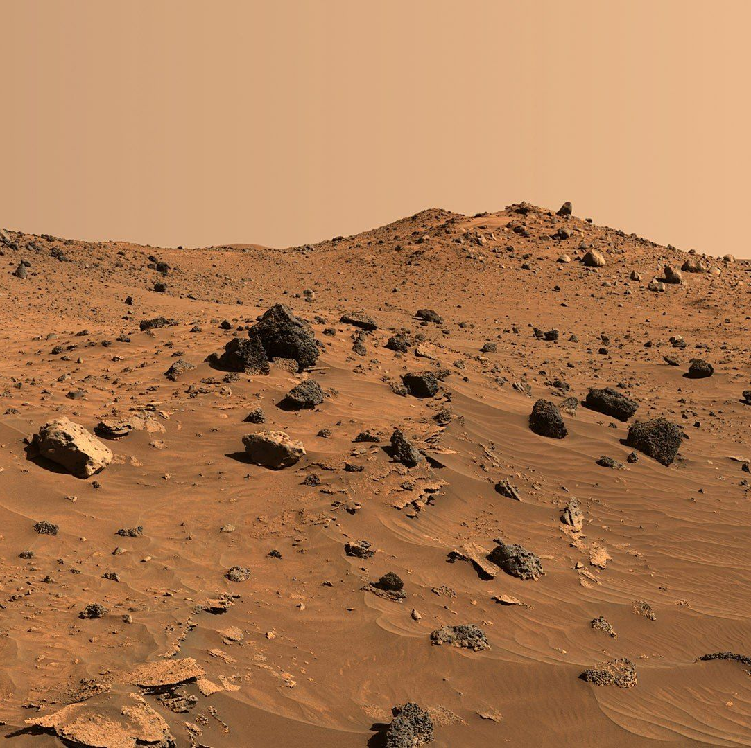
Let’s Talk About Mars
1/3 Earth's Gravity
Thin CO2 Atmosphere
Cold Temperatures
Dust Storms
Craters, Volcanoes, Valleys
Notes:
Mars, often called the "Red Planet," is the fourth planet from the Sun and one of Earth's closest neighbors. Despite being relatively close, Mars is a very different and much harsher environment. Let's look at a few key aspects that are important to know before building a rover for Mars.
Gravity: Mars has only about 38% of Earth's gravity. That means if you weigh 100 pounds on Earth, you would weigh just 38 pounds on Mars. This lower gravity affects how objects move and how much traction a rover has. Lighter gravity means a rover can travel farther with less effort, but it also means that it can more easily slip or bounce, especially on rocky or sloped terrain. Designing a rover that can stay stable despite lighter gravity is a key engineering challenge.
Atmosphere and Weather: Mars’ atmosphere is extremely thin — it's less than 1% as dense as Earth's atmosphere. It is made up mostly of carbon dioxide (CO₂), with only traces of oxygen and water vapor. Because the atmosphere is so thin, it doesn't trap heat well, which leads to extreme temperature swings.
* Daytime temperatures near the equator can reach about 70°F (20°C), but at night, temperatures can drop to -100°F (-73°C) or colder!
* Mars also experiences massive dust storms. Some dust storms are local, while others can grow and cover the entire planet for weeks. These storms can block sunlight, which is dangerous for solar-powered rovers. Dust also tends to settle on solar panels, reducing their efficiency.
Surface Topology and Features: Mars has some of the most dramatic surface features in the Solar System.
* Olympus Mons is the tallest volcano (and mountain) in the Solar System, standing about three times taller than Mount Everest!
* Valles Marineris is a canyon system that stretches over 2,500 miles (4,000 kilometers) — that's about as wide as the entire United States.
* Mars’ surface also has impact craters, ancient riverbeds, valleys, and polar ice caps.
Some regions are smooth and flat, good for landing, while others are rocky and rugged — perfect for scientific exploration but risky for rover mobility.
Terrain and Soil (Regolith): The ground on Mars is covered by a layer of dust and broken rock called regolith. The regolith is very fine, dusty, and rich in iron oxide, giving Mars its reddish color. Some areas have large rocks and boulders, while others have loose sandy soil that can trap rover wheels (like it did to Spirit!).
Designing wheels that can handle both sharp rocks and soft sand is critical. Rovers also need to be able to climb slopes, sometimes up to 30°, without tipping over.
Summary: Mars is a cold, dusty, low-gravity world with dramatic landscapes and dangerous weather. When building a rover, you have to design it tough enough to handle rough terrain, smart enough to survive dust storms, and sturdy enough to keep from tipping or getting stuck!

Slide 8
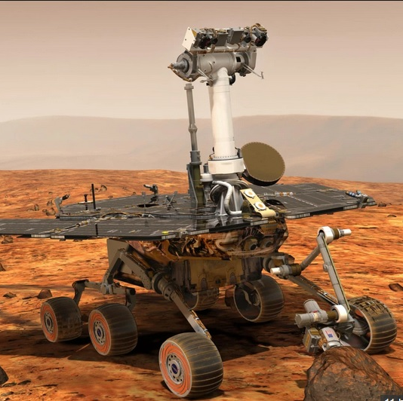
Challenges for a Mars Rover
Rough Terrain
Power Requirements
Communication Delays
Hazards
Limited Repair Options
Notes:
Building a rover for Mars isn’t just about making something that can drive — it's about surviving some of the harshest conditions in the Solar System. Engineers face many major challenges when designing Mars rovers. Let’s explore them:
Rough Terrain: Mars has incredibly rough and unpredictable terrain. The surface is covered with rocks, boulders, sand dunes, craters, and steep slopes. A rover needs a highly durable suspension system and specially designed wheels that can climb over rocks, navigate sandy patches without sinking, and handle sharp changes in elevation.
For example, the Curiosity and Perseverance rovers use a rocker-bogie suspension system that allows them to drive over obstacles up to twice the diameter of their wheels! Even so, engineers must be careful — sharp rocks have punctured rover wheels before (as seen with Curiosity).
Power Needs: Because Mars is so far from the Sun, and because of frequent dust storms, generating enough power is a real challenge.
* Solar-powered rovers (like Spirit, Opportunity, and Zhurong) rely on sunlight. Dust storms or dust accumulation on panels can block solar energy, risking mission failure.
* Nuclear-powered rovers (like Curiosity and Perseverance) carry a Radioisotope Thermoelectric Generator (RTG), which produces steady power regardless of weather or sunlight, but is heavier and more expensive. Choosing the right power system is crucial based on the mission length and location.
Communication Delays: Mars is millions of kilometers away from Earth. Depending on the positions of the two planets, it takes between 5 and 20 minutes for a signal to travel one way. This delay means that rovers can’t be driven like remote-control cars. Instead, they must be semi-autonomous — capable of making small decisions on their own, like stopping if an obstacle is detected.
Mission planners send daily commands to the rover, but the rover must navigate and act independently throughout the day.
Hazards and Environmental Risks: The thin atmosphere of Mars offers no protection from radiation or meteoroid impacts.
* Rovers are exposed to higher levels of cosmic radiation than anything on Earth, which can damage electronic systems over time.
* Dust is a huge hazard. It can clog joints, scratch camera lenses, reduce solar efficiency, and obscure scientific instruments.
* Temperature extremes — swinging between hot daytime and freezing nighttime temperatures — can cause materials to expand and contract, potentially breaking parts over time.
Limited Repair Options: Unlike robots on Earth, a rover cannot be manually repaired once it’s on Mars. Every part must be built for extreme durability and redundancy.
* If a wheel breaks, the rover must continue on fewer wheels.
* If an instrument fails, the mission must find ways to continue using the remaining tools. Spirit, for example, continued its mission after losing a wheel, dragging it behind and accidentally discovering important silica deposits.
Summary: A successful Mars rover needs to survive rough terrain, generate enough power, make smart choices on its own, handle dangerous weather and radiation, and keep operating with no chance of repair. Every rover mission is a balance between durability, adaptability, and scientific capability!

Slide 9

NASA's Mars Rovers
Sojourner (1997)
Spirit (2004–2010)
Opportunity (2004–2018)
Curiosity (2012–Present)
Perseverance (2021–Present)
Ingenuity Helicopter (2021–Present)

Slide 10
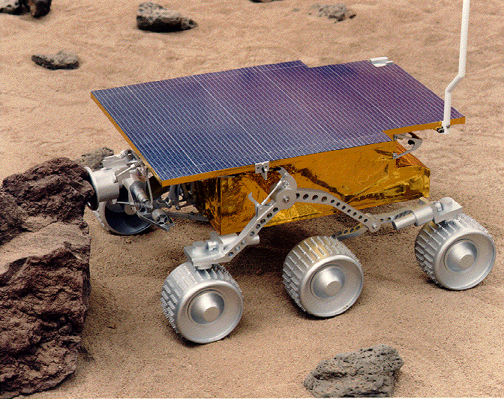
Sojourner (1997)
First Mars rover (Part of Pathfinder Mission)
Size: Small (Microwave-sized)
Mission: Mobility & Science Experiments
Fun Fact: Designed for 7 days, lasted 83 days
Notes:
Sojourner was the first rover to operate successfully on Mars. Launched as part of the Mars Pathfinder mission, it landed on July 4, 1997, in the Ares Vallis region. Weighing just about 23 pounds (11 kilograms) and measuring 65 centimeters long, Sojourner was designed primarily as a technology demonstration. It proved that a rover could move across the Martian surface and conduct experiments remotely.
Sojourner used six wheels and a rocker-bogie suspension system, which is still the standard design for modern Mars rovers. It was powered by solar panels, which recharged its batteries each day. The rover carried several scientific instruments, including an Alpha Proton X-ray Spectrometer to analyze rock composition, and three cameras. It traveled slowly — about 1 centimeter per second — and covered a total of about 100 meters during its mission.
While its primary goal was to test mobility, Sojourner also performed chemical analyses of rocks and soil, providing the first close-up studies of Martian geology. The lander itself, named the Carl Sagan Memorial Station, acted as a relay station for communications.
Although Sojourner was only designed for a seven-day mission, it far outlasted expectations, surviving for 83 days. Its success was pivotal, proving the value of mobile exploration and inspiring the design of future rovers. Fun fact: the rover was named after Sojourner Truth, an abolitionist and women's rights activist, through a student essay competition.

Slide 11
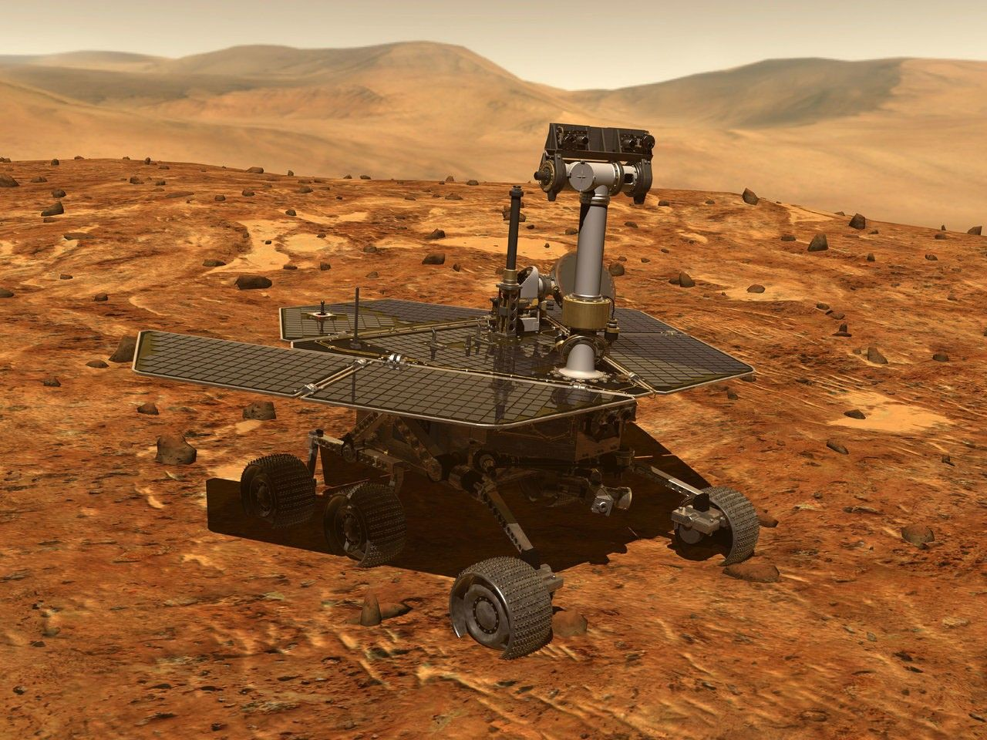
Spirit (2004–2010)
Twin of Opportunity
Explored Gusev Crater
Got stuck but continued stationary science
Discovered water evidence
Notes:
Spirit, one of NASA’s twin Mars Exploration Rovers, landed in Gusev Crater on January 4, 2004. It was designed for a 90-day mission to study Mars' geology and search for signs of past water. Spirit weighed about 400 pounds (185 kilograms) and was powered by solar panels.
Equipped with panoramic and navigation cameras, a rock abrasion tool, a miniature thermal emission spectrometer, and a microscopic imager, Spirit could analyze rocks and soil up-close. One major early discovery was volcanic rocks, confirming that Mars had volcanic activity in its past.
In 2006, Spirit lost the use of its right front wheel. Remarkably, the team continued operating it in reverse, dragging the wheel behind. In doing so, Spirit unintentionally uncovered soil deposits with high concentrations of silica — strong evidence of past hot springs or hydrothermal activity, which are key environments for potential past life.
Unfortunately, in 2009, Spirit became trapped in soft soil near a feature called "Troy." Despite efforts to free it, Spirit remained immobilized. Scientists transitioned Spirit into a stationary science platform, using it to monitor Mars' atmosphere and conduct soil analysis. Spirit sent its last communication in March 2010, and after several months of silence, NASA declared the mission complete.
Spirit traveled approximately 4.8 miles (7.7 kilometers) — far more than its original goal — and made numerous groundbreaking discoveries, greatly expanding our understanding of Mars’ watery past.

Slide 12
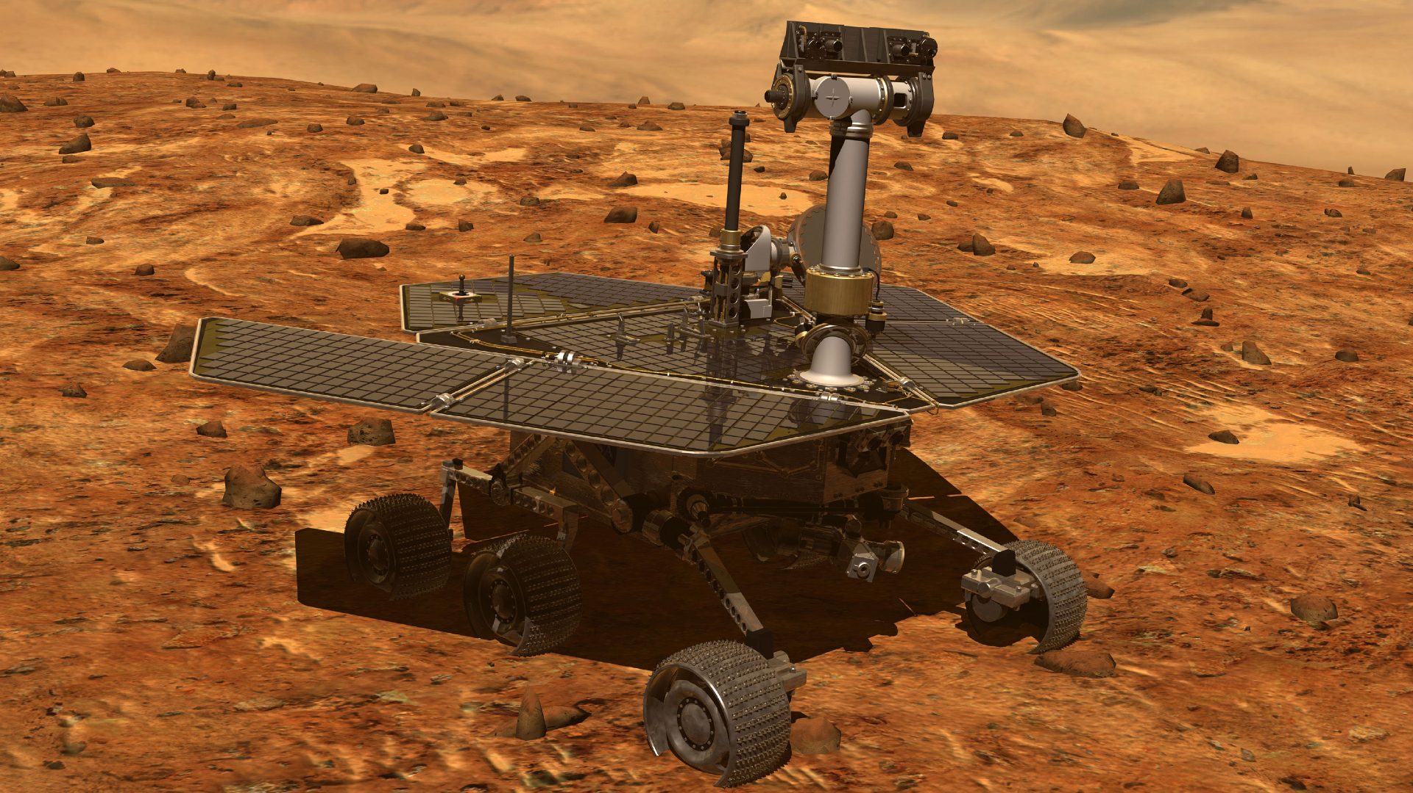
Opportunity (2004–2018)
Nickname: "Oppy"
Lasted nearly 15 years (planned for 90 days)
Traveled 28 miles
Found signs of ancient water
Notes:
Opportunity, Spirit’s twin, landed on January 25, 2004, on the opposite side of Mars at Meridiani Planum. Like Spirit, it had a planned mission life of 90 sols (Mars days) but operated for nearly 15 years — one of the most extraordinary success stories in robotic space exploration.
Opportunity’s primary goal was to investigate rocks and soils for clues to past water activity. Within weeks of landing, it discovered small spherical formations called "blueberries" made of hematite — a mineral that typically forms in water, providing strong evidence of Mars' wetter past. Throughout its mission, Opportunity explored craters, traveled across plains, and survived numerous Martian winters by carefully adjusting its position to maximize solar energy intake.
The rover was equipped with panoramic cameras, a rock abrasion tool, spectrometers, and a microscopic imager. It transmitted over 200,000 images to Earth and traveled over 28 miles (45 kilometers), setting a record for the longest distance traveled by any extraterrestrial vehicle.
In June 2018, a massive planet-wide dust storm covered Opportunity's solar panels, cutting off its power. After months of attempting to re-establish contact, NASA officially ended the mission in February 2019. Opportunity’s last emotional message relayed back to Earth was interpreted as: “My battery is low, and it’s getting dark.”
Opportunity's mission changed humanity's understanding of Mars, showing that the Red Planet once had conditions that could have supported microbial life.

Slide 13
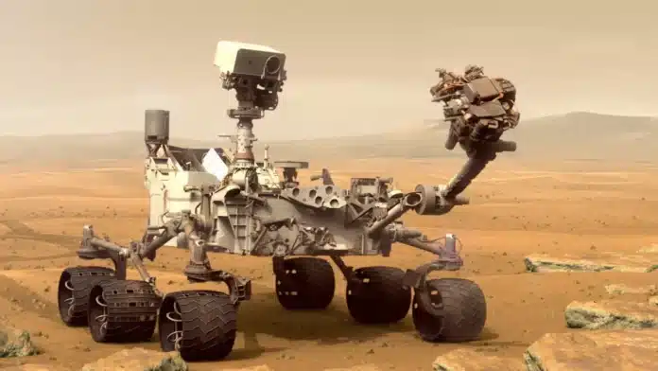
Curiosity (2012–Present)
Nuclear-powered
Exploring Gale Crater
Studied Mars climate and organic molecules
Famous for its selfies
Notes:
Curiosity is a car-sized rover launched aboard an Atlas V rocket and landed in Gale Crater on August 6, 2012, using a daring sky-crane maneuver. Unlike previous solar-powered rovers, Curiosity uses a radioisotope thermoelectric generator (RTG), providing continuous power regardless of sunlight.
Weighing about 2,000 pounds (900 kilograms), Curiosity carries an impressive suite of scientific instruments. These include cameras, spectrometers, a laser (ChemCam) to vaporize and analyze rocks, environmental sensors, and a drill capable of extracting subsurface samples. Its goal is to assess Mars' habitability, study climate and geology, and prepare for human exploration.
One of Curiosity’s major discoveries is evidence that Gale Crater once contained a long-lasting freshwater lake. It also detected complex organic molecules — the building blocks of life — preserved in ancient rocks. Curiosity continues to explore the lower slopes of Mount Sharp (Aeolis Mons), analyzing rock layers that record Mars’ environmental history over billions of years.
The rover has made "selfies" famous by using its robotic arm-mounted camera to stitch together images. Curiosity remains operational today and is one of NASA’s most productive science missions.

Slide 14
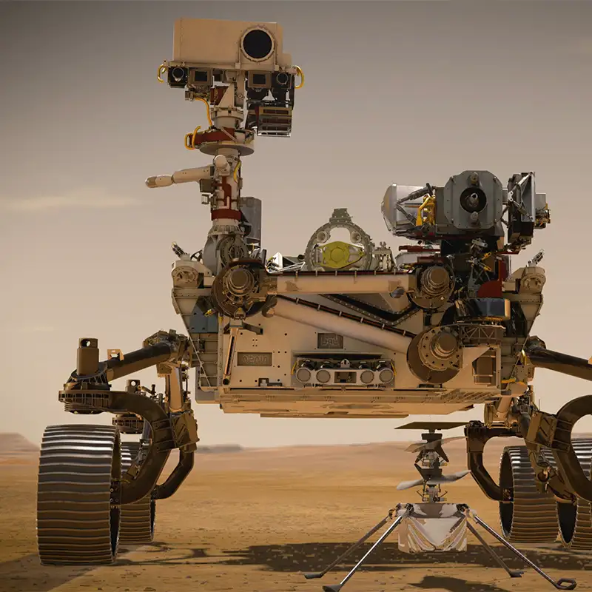
Perseverance (2021–Present)
Searching for ancient life
Landed in Jezero Crater
Experiments: Oxygen Production
Rover buddy: Ingenuity helicopter
Notes:
Perseverance, nicknamed "Percy," landed spectacularly in Jezero Crater on February 18, 2021, using enhanced sky-crane technology. It builds on Curiosity’s design but includes even more advanced tools to search for signs of ancient microbial life and collect samples for future return to Earth.
Weighing about 2,260 pounds (1,025 kilograms), Perseverance is equipped with a drill to core and cache rock samples, high-resolution cameras, ground-penetrating radar (RIMFAX), and environmental instruments. It also carries the MOXIE experiment, successfully producing oxygen from Mars' carbon dioxide-rich atmosphere — a technology that could support future astronauts.
Percy’s prime exploration site, the ancient river delta in Jezero Crater, offers some of the best evidence for habitable conditions on early Mars. It has already collected dozens of core samples and is preparing to transfer them to future missions.
In addition, Perseverance deployed Ingenuity, the first aircraft ever to fly on another planet, further proving the feasibility of aerial exploration in Mars' thin atmosphere.

Slide 15
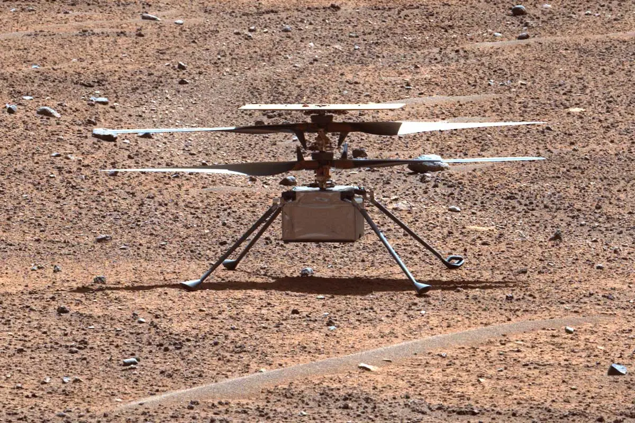
Ingenuity Helicopter (2021–Present)
First powered flight on another planet
Tiny drone
Successful flights far beyond original plan
Notes:
Ingenuity is a small drone helicopter, weighing about 4 pounds (1.8 kilograms), with a wingspan of about 4 feet. Initially planned for five test flights, Ingenuity far exceeded expectations, performing scouting missions to aid Perseverance's route planning.
Its success is groundbreaking: powered flight in Mars’ ultra-thin atmosphere (less than 1% of Earth’s pressure) required innovative technology, including ultra-light materials, high-speed rotors, and autonomous navigation. Ingenuity has demonstrated that flight can play a crucial role in future Mars exploration, offering a bird’s-eye view of terrain that is difficult for rovers to cross.

Slide 16
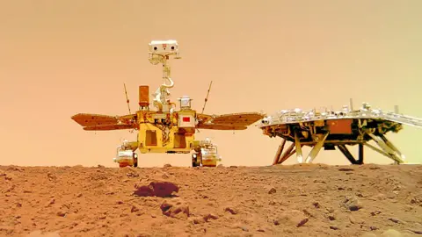
Zhurong (2021–Present)
China's first successful Mars rover (Tianwen-1 Mission)
Landed in Utopia Planitia
Solar-powered, about 530 pounds
Mission: Study soil, climate, magnetic fields, and underground water-ice
Entered hibernation after dust storms; current status: inactive
Notes:
Zhurong is part of China’s Tianwen-1 mission, which made China the second country after the United States to successfully land and operate a rover on Mars. It landed on May 14, 2021 in Utopia Planitia, a vast plain that may have once held an ancient ocean.
The rover’s name, Zhurong, comes from a mythological Chinese fire god, symbolizing exploration and discovery. The Tianwen-1 spacecraft was notable because it carried an orbiter, lander, and rover all in one launch — an ambitious approach that worked perfectly.
Zhurong is about the size of NASA’s Spirit and Opportunity rovers, weighing 530 pounds (240 kilograms). It runs on solar power and uses six wheels to navigate Mars’ rocky and sandy surface. It carries scientific instruments to study the soil, search for underground ice, measure the weather, and analyze the magnetic field.
During its active mission, Zhurong traveled about 2 kilometers (1.2 miles) and sent back important data. It even staged a creative selfie with its lander by placing a wireless camera on the ground — the first time a Mars rover captured a picture of itself this way!
In May 2022, Zhurong entered hibernation for the Martian winter. Unfortunately, as of 2023, it has not reawakened, likely due to dust covering its solar panels. Despite this, Zhurong’s mission is seen as a major success and a key milestone for China’s growing space program.

Slide 17
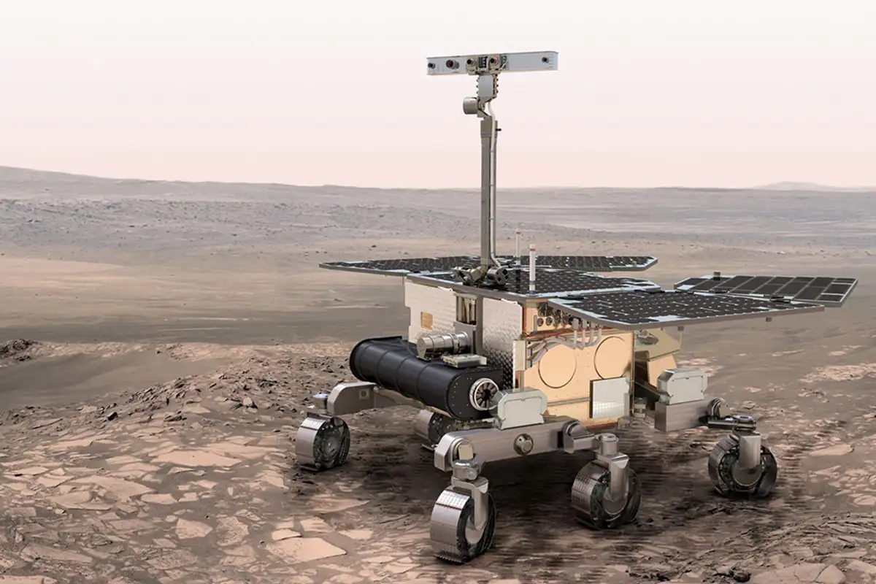
Other Mars Rover Attempts
Soviet Union:
Mars 2 (1971): First spacecraft to reach Mars, but crash landed.
Mars 3 (1971): Successfully landed, but lost contact after 2000s.
Europe (ESA):
Beagle 2 (2003): Designed to land and explore but failed to fully deploy after landing.
Future Mission:
ExoMars: Planned by ESA; launch expected in the late 2020s.

Slide 18
Brainstorm
Come up with a Team Name
What should your rover be able to do?
Brainstorm features: wheels, cameras, arms, sensors

Slide 19
Wrap-Up
Recap of today's activities
Preview of tomorrow's rover design session
Homework: Think of a cool name for your rover

